Slide 1

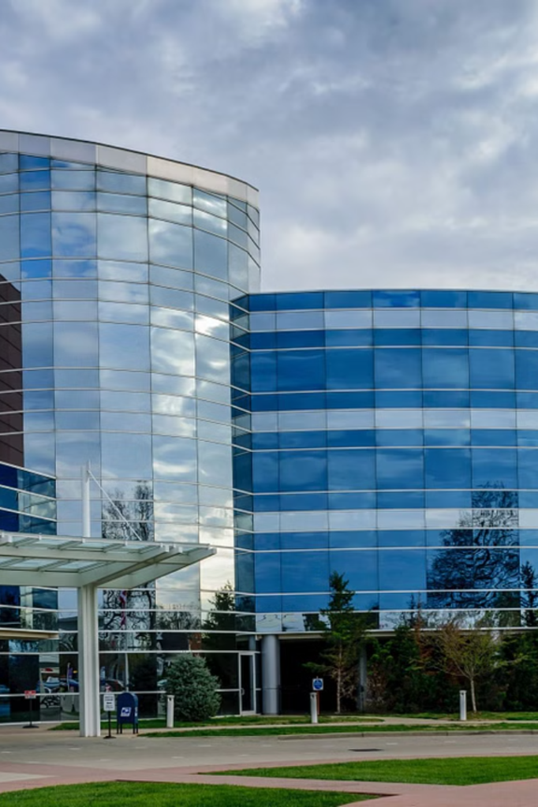
Name of the School: School of Computer Science and Engineering
Course Code: R1UC201C Course Name: OOPS USING JAVA
PROJECT TITLE
Healthcare Management System
Team Details:
Name(Admission No):
Ayush Kumar (24SCSE1180496)
Abhishek Kumar Sharma (24SCSE1180642)
Ronit RAJ (24SCSE1180136)
Ayush Jha (24SCSE1180317)
Section: 41 (AIML)

Slide 2
Name of the School: School of Computer Science and Engineering
Course Code: R1UC201C Course Name: OOPS USING JAVA
Objective
Modular Design and Scalability
This system is modular and scalable to accommodate different healthcare facilities and evolving needs.
Through using JAVA principal we create reusable modules for different components like patients
management, doctors schedules, billing, inventory etc.
Security and Data Privacy
Ensure a higher levels of protection of highly sensitives Healthcare data and privacy for all billings
transaction and patients information.
Performance Optimization
This system handle high volumes of transactions and data without performance bottlenecks and optimize
the garbage collection process to avoid memory leaks.

Slide 3



Name of the School: School of Computer Science and Engineering
Course Code: R1UC201C Course Name: OOPS USING JAVA
Problem Statement
Data Aggregation
Security challenges
Communication and collaboration
Consolidated data of a various hospital management System like patients data, medical record, billing system,
Appointment Scheduling
Sensitive medical data is at risk of unauthorized access, breaches, or leaks due to weak security protocols
Communication gaps between departments, doctors, and patients can lead to delay in treatment and confusion over medical instruction.

Slide 4
Name of the School: School of Computer Science and Engineering
Course Code: R1UC201C Course Name: OOPS USING JAVA
System Architecture
4
PRESENTATION LAYER
DATA ACCESS LAYER
DATABASE LAYER
SECURITY LEVELS
This layer is responsible for different user type like doctors, patients and administrators.
The data access layer is a seamless interaction for performing CRUD (Create, read, Update ,Delete)
The system stores all patients user experience providing with the database and appointments and billing details.in a relational database ,such as MySQL, PostgreSQL or Oracle database.
Security is a critical aspect of the user interface(UI) and responsible for interacting information, medical records, System architecture .

Slide 5

Name of the School: School of Computer Science and Engineering
Course Code: R1UC201C Course Name: OOPS USING JAVA
Technical Stack :
JAVA DATABASE FRONT-END TECHNOLOGIES:
The core programming Language used for
Developing the backend.
And business logic.
MySQL or PostgreSQL: Popular relational databases used for storing patients record, appointment, billing Information etc. Both support ACID transactions, ensuring data integrity.
HTML/CSS: For structuring and styling the user interface in web-based application. JAVA Script: For client-side interactivity

Slide 6
Name of the School: School of Computer Science and Engineering
Course Code: R1UC201C Course Name: OOPS USING JAVA
Conclusion and Future Enhancements
Conclusion
Future Enhancement
Artificial intelligence and ML Pharmacy Management Telemedicine Feature
The Healthcare Management system(HMS) developed using JAVA provides a comprehensive solution to address many of the critical challenges faced by healthcare institutions . By integrating functionalities such as patient data management ,appointment scheduling, medical record handling, billing automation, and secure data processing etc. The HMS offers a user-friendly interface for both healthcare providers and patients, streamlining communication.
.
Adding a pharmacy management module to manage inventory, prescriptions, and medication dispensing could streamline the
Virtual health outcome.
This system could be
enhanced with
telemedicine capabilities,
allowing doctors to conduct
The medication process.
Incorporating AI and machine learning algorithms can improve decision-making by providing predictive analytics for patient consultation .

